Slide 1
Organ Donation
http://www.youtube.com/watch?v=XuXYVLTisW4

Slide 2
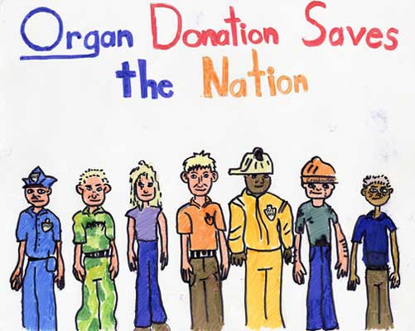
The Numbers
# of people waiting for an organ transplant-109,914
# of people that die daily while waiting-18
# of transplants as of November 19, 2010-19,249
Every 10 minutes another name is added to the list

Slide 3
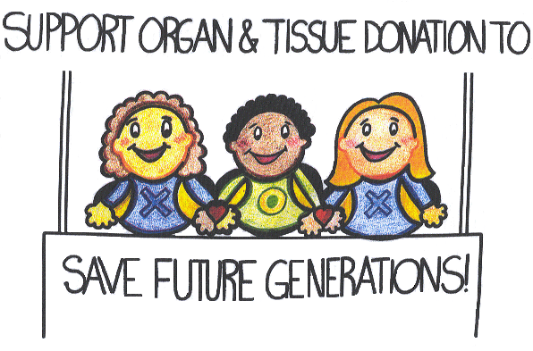
What can be donated?
Organs: heart, kidneys, pancreas, lungs, liver & intestines
Tissue: cornea, skin, heart valves, bone, blood vessels, & connective tissue
Other: bone marrow, stem cells
1 organ donor can save 8 lives and enhance up to 100

Slide 4
Common Myths
If I agree to donate my organs, the hospital won’t work as hard to save my life.
Organ donation is against my religion.
An open-casket funeral isn’t an option for people who have donated organs or tissues.
My family will be charged if I donate my organs.
Maybe I won’t really be dead when they sign my death certificate.

Slide 5
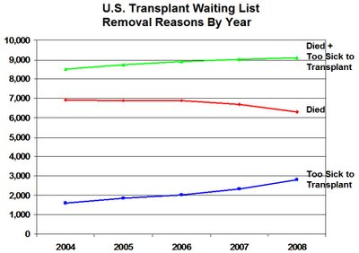

Slide 6
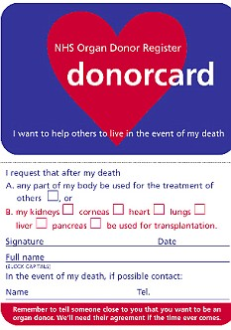
What can you do?

Slide 7
Sources
www.unos.org
www.donatelife.net
www.mayoclinic.com
www.hrsa.gov
www.liverfoundation.org

